Slide 1

Welcome: Educators Toolkit
CANDLE, Inc./Reality Tour
Nonprofit Leader For:
Innovative & Contemporary
Drug Prevention
Education Resources
www.CANDLEinc.org
Resources for Communities, Schools & Parents
Notes:
Community Action Network for Drug-free Lifestyle Empowerment, Inc. (CANDLE, Inc.) impacts prevention nationally through their parent/child ‘Reality Tour Drug Prevention Program’ that is replicated in U. S. communities. It is the mission of CANDLE, Inc. to provide innovative, contemporary and actionable prevention measures to help communities, schools and parents combat drug trends.

Slide 2

Inhalant Misuse Education
The nonprofit Community Action Network for Drug-free Lifestyle Empowerment (CANDLE, Inc.)
connects parents and educators with information to address inhalant misuse including whippets. For student, parent, community and staff education
CANDLE, Inc. is pleased to be of assistance to the Whippet Wipeout Campaign Education Committee in SW Detroit 2020-21
Whippet Wipeout Campaign SW Detroit, MI.
Notes
accompany each slide.
Notes:
Inhalant misuse can be overlooked because it is rather hidden and usually doesn’t make news headlines like street drugs. Yet this ‘poison’ that is found in every home can be deadly with the first use. CANDLE, Inc. has researched appropriate educational resources for the target audience you need to reach. Use the information provided where it is most appropriate.

Slide 3


Risk Factors
Age of 1st use
Availability – Over a thousand household substances
Family history of substance misuse
Personal history of mental health issues
Misinformation on dangers of misuse via social media
Glorification for use – music, videos etc.
Perceived as a safe item because it is household item
64% Increase in use of inhalants by 8th graders
2019-202O Monitoring the Future Survey
Notes:
The age of onset for drug experimentation increases the chance of use of other drugs and addiction. This is a list of notable risk factors with one of the most significant being the increase in use by 8th graders.
64 % increase over prior year from 8th grade students. Monitoring the Future 2020

Slide 4

Protective Factors
Parents & Educators be informed
Classroom – Monitor use of inhalants
markers, glue, Dust Off. Inform parents if
misuse happening in school
Home – Be aware of increase in need to replace household aerosols, spray paint, hair spray
Insure that youth get the message on the danger
Equate that inhalants are poison when misused
Notes:
There are over 1,000 items that enhance our daily living that are in the inhalant category. Fumes can be inhaled from paint thinner and gasoline for example. Item like hairspray and deodorant spray can be expelled into a bag for concentrated inhaling. Question if a household product needs replaced earlier that you anticipated.

Slide 5
Know the Signs of Inhalant Misuse
Memory loss
Tongue may feel numb
Change in behavior/friends
Paraphernalia: bags, rags, paper tubes stuffed with tissue, soda
cans, empty perfume/cologne bottles
Disorientated to surroundings
Anxious, irritable, restless
Slurred speech, dark circles under eyes
Chemical odor to breath
Seizures
Whippets, balloons & cracker discards
FIRST USE MAY BE FATAL
Notes:
Jeff Williams a police officer who lost his son Kyle to inhalant abuse of Dust Off, recalled that Kyle complained of his tongue being numb, and Kyle had dark circles under his eyes and became increasingly irritable. Just as in Jeff’s case, it is all too often that these sign don’t add up to inhalant abuse to parents, since prevention for that particular ‘poison’ isn’t mainstream.
THC ↑ 212%

Slide 6
Long Term Effects of Inhalant Misuse
Lung, liver & kidney damage
Hearing loss
Weakened immune system
Seizures
Heart rhythm disturbance
Coma
Damage to brain, nervous system, paralysis
Death
Notes:
Long term effects of misuse can be debilitating for life and be so significant that a person can no longer take care of their own needs. Here is a link to the story of a young mom now in a wheelchair due to nitrous oxide misuse:
https://youtu.be/JTkKIewcArg Death can result in first use. Note that persons under the influence can also cause harm or even death through their actions. TV news account of a young child killed by impaired driver: https://www.youtube.com/watch?v=XpDfrYrqIxg

Slide 7
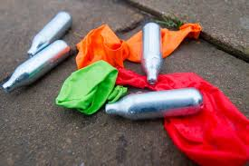
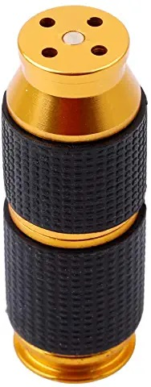
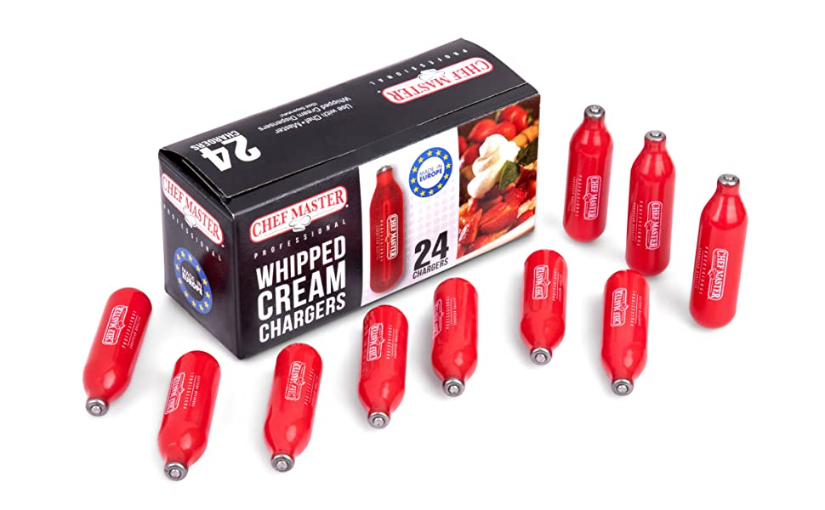
One of Most Abused Inhalants
Whippets
Nitrous Oxide N20
(Laughing Gas)
Can be fatal 1st use
Damage to brain
Damage to organs
Sold at gas stations, party stores, online
Link to N20 Flyer
Notes:
Nitrous oxide or N20 is also known as laughing gas for dental procedures. N20 is encased in cartridges called whippets and sold for use in commercial whipped cream dispensers and is frequently purchased for the purpose of inhaling through a balloon. The item on the extreme right is a ‘cracker’ used to puncture and extract the N20. This item is even sold in dollar stores and has only one purpose. Here is a link to a flyer to alert to the use and danger: https://bit.ly/3GlLOe7 This ‘poison’ adds even great concern knowing that the rate of use increased 64% over prior year (2019) for students in 8th grade. Statistics from Monitoring the Future survey 2020/
THC ↑ 212%

Slide 8

Inhalants Harm Your Brain - Elementary/Middle School
Notes:
Video suitable for students through middle school years.
This video is just 1:40 embedded from YouTube https://youtu.be/acOF7ZGt4ng

Slide 9

Inhalants - Testimony of Harm Middle School – High School
Notes:
This testimony of Nitrous Oxide users emphasizes the harm and uselessness of abusing N20. I is appropriate for Middle School and High School students to demonstrate harm of N20 one of the most popular inhalants. Often N20 filled balloons will be sold at concerts and openly used. Direct link to video: https://youtu.be/392jFOsvpoQ

Slide 10
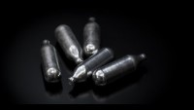
Effects Can Last a Lifetime

Slide 11
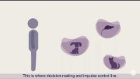
Addiction & the Brain
Notes:
Exposure to any drug during the adolescent and teen years impact the brain differently than at any other time of life. Significant changes occur when substance misuse is introduced and override the ability to make healthy choices.
The Addiction Policy Forum created this brief video to demonstrate the effect. The video is embedded but you can use this link: https://youtu.be/jj4maao-9XI

Slide 12
Cautions for Active User Encounter
Do not leave the person alone
Do not escalate if agitated*
Get person to a safe place
Call 911
Try to determine the source of inhalant
*Hallucinations, heart rate symptoms may escalate
during an encounter increasing health risk.
Notes:
In cases where the person exhibits profound symptoms of impairment, it is important not to raise the level of agitation that can lead to an immediate health emergency.

Slide 13
Resource for Treatment Providers
Dignity, Diversion, Home & Hope
Australia approach to intervention:
https://www.niaa.gov.au/sites/default/files/publications/YETI_dignity_diversion_home_hope.pdf
2010 Inhalant Abuse Study
Health Canada, First Nation
https://www.ncbi.nlm.nih.gov/pmc/articles/PMC2948777/
Diagnostic Tests:
Elevated liver enzymes
Gas chromatography
Urine for chemicals
Notes:
The United States lags behind other countries in addressing inhalant misuse and specific recommended treatment measures. A Cleveland Clinic webpage details the diagnostic tests for inhalant misuse. https://my.clevelandclinic.org/health/diseases/15742-inhalant-abuse. Frequently, inhalant abuse accompanies abuse of other substances that make seeking proper treatment complicated.

Slide 14

Prevention can help every parent, every child ‘See beyond the next 10 min.’
Inquire about our community-based Reality Tour prevention program.
Educate parent & child together.
CANDLEinc.org
Notes:
“Our slogan is “See beyond the next 10 minutes” This relates to a young man, when asked how he stayed drug-free when many friends didn’t, said. “I could always see beyond the next 10 minutes.” The nonprofit CANDLE, Inc. wants every child and every parent to be able to ‘See beyond the next 10 minutes’ when it comes to prevention. For information on a community approach to prevention contact RealityTour@candleinc.org

